Slide 1

B.R.E.A.T.H.E
Balanced Responsive Environmental Airflow and Temperature Housing Enhancer
Senior Design: Group 40
Sponsored by: Dr. Qun Zhou Sun

Slide 2




OUR TEAM
Emily Baross
Kyle Ingleton
Marcus Loyd
Patrick Tumbos
Electrical
Engineering
Electrical
Engineering
Computer
Engineering
Computer Engineering

Slide 3
01
Motivation & Background

Slide 4

Motivation and background
Issues like inconsistent airflow and poor temperature regulation.
Health implications of inadequate ventilation (e.g., carbon dioxide circulation).
Addressing discomfort in hot climates like Florida.
4500+
ppm
Very unhealthy (Exposure time limit must NOT exceed 8 hours)
2500
ppm
Negative impact on health (drowsiness and poor air quality)
1200
ppm
Upper limit for indoor concentration (stuffy/ stale air quality)
450 ppm
Acceptable conditions (outdoor air levels)
Carbon Dioxide Concentration Levels

Slide 5
02
Goals & Objectives

Slide 6
Goals
Basic Goals
The vent can be opened or closed remotely from user input.
Autonomous control of the vent will be based on user-specified temperature parameters.
The temperature of the room in which the vent is located will be regulated based on user input.
BREATHE will have a sensor that will sense the Carbon Dioxide levels in a room.
A buzzer will alert the user during necessary situations.
The power system will ensure a reliable delivery of power to each necessary component.
The device will be easy for the user to control and adjust.
Stretch Goals
The user can open the vent to a desired angle.
A mobile application will be used as a secondary way to control BREATHE.
BREATHE will incorporate a fan behind the vent to be used as a power generation feature similar to a wind turbine in order to increase battery life of the vent interaction subsystem.
BREATHE will incorporate a fan behind the vent to be used in the event that Carbon dioxide levels are high and increase airflow into the room to dissipate excess Carbon dioxide

Slide 7
Objectives
Efficient Ventilation System: Adjust airflow based on environmental conditions to maintain a comfortable living space. Such as temperature variations or CO2 levels exceeding 4500pm.
Autonomous Mode: Enable automatic adjustment of vent louvers based on user-set temperature preferences using various sensors and a servo motor.
Manual Control Capability: Allow users a manual override on the current vent position via a control unit.
Control Unit: Utilize a touchscreen LCD and sensors to accurately monitor temperature and CO2 levels and display warnings such as low battery and high CO2 levels.
Peripherals: Utilize high-precision temperature and CO2 sensors to provide real-time and reliable data.
Bluetooth Connectivity: Enable communication between MCUs for seamless operation.
Audible Alert System: Integrate a buzzer to provide clear and immediate audio alerts for critical warnings, such as low battery levels and high CO2 concentrations, ensuring user awareness and timely action.
Power System: Develop a robust power supply capable of powering all subsystems while optimizing energy usage through various low power modes.

Slide 8
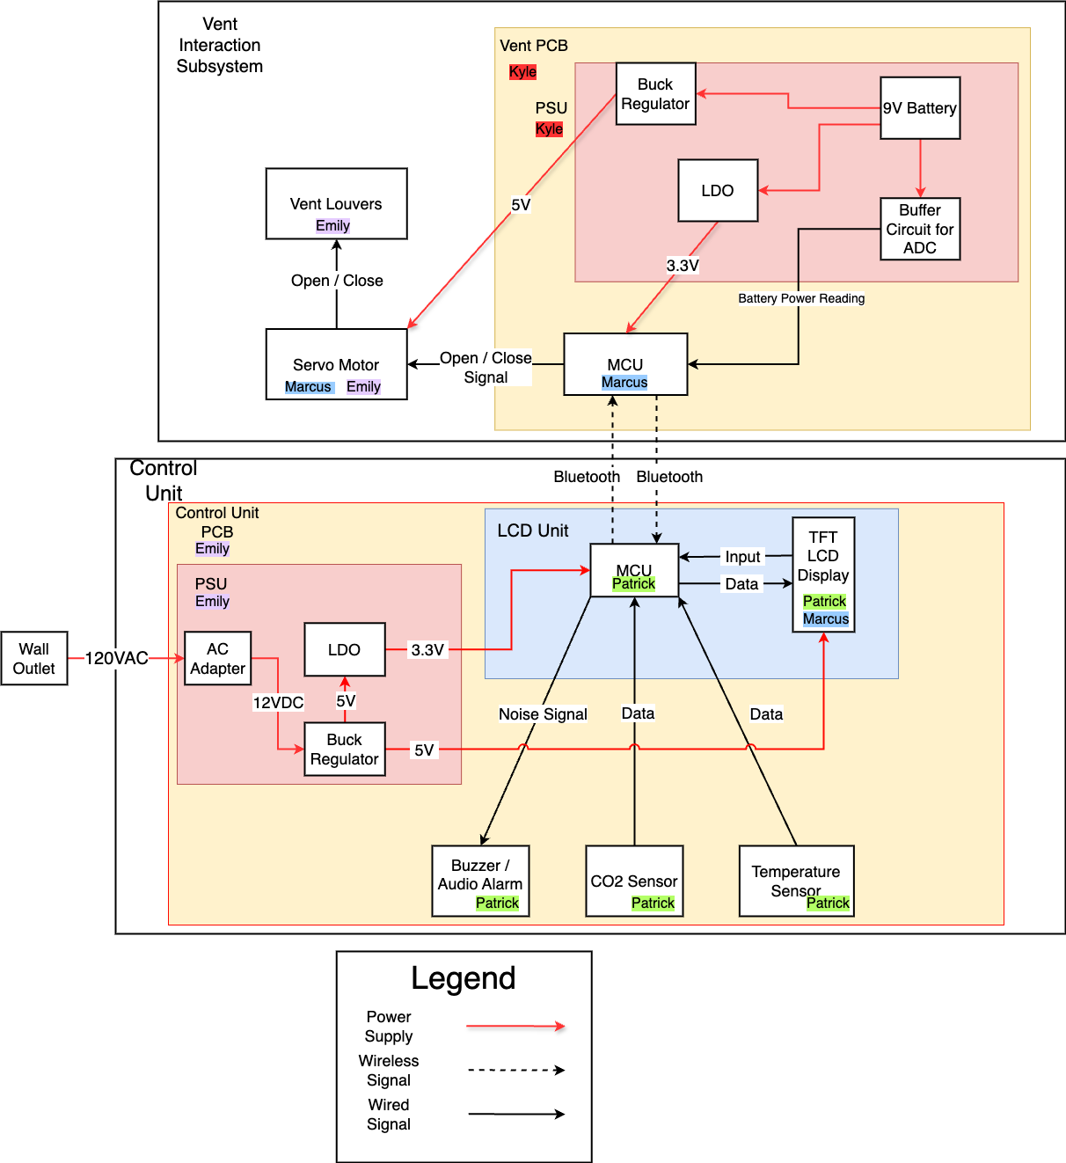
Hardware
Block Diagram

Slide 9
03
Engineering Specifications

Slide 10
Specification | Quantitative Measure
Manual Vent Control | Vent can be in 1 of 2 positions, open or closed, from manual user input
Autonomous Vent Control | If the temperature variation is ±2°F from the desired temperature set by the user then the vent should open or close depending on whether it is above or below the desired temperature.
Sensor Accuracy | Temperature reading should be accurate to ±1°F and CO₂ reading should be accurate to ±50 ppm
Sensor Operating Range | Temperature sensor operation range should be from -40 to 176 °F, whereas the CO₂ sensor operation range should be from 0 ppm to 5000 ppm
Battery Life | Minimum duration of 6 months before needing replacement
Bluetooth Range | Bluetooth communication should work up to a 10-meter range
Dimensions | 12 x 6 inches
Audio Alarm System | Alarm sounds when CO₂ exceeds 4500 ppm and also when the battery of the vent control unit is below 10% capacity it will sound intermittently at a lower pitch and volume. There should be only a ≤10% chance of a false alarm occurring.
Vent Actuation System | Vent will be able to fully open or close within 5 seconds

Slide 11
04
Hardware Selection

Slide 12
MCU Selection
 | ESP32 |  | nRF52832 |  | STM32WB09ke | MSP430FR6989
Current Consumption | 100mA |  | 100uA |  | 1.6mA | 100uA
Operating Frequency | 80 MHz to 240 MHz |  | 64 MHz |  | 64 MHz | 16 MHz
Integrated BLE | Yes |  | Yes |  | Yes | No
Ease of Integration | High |  | High / Moderate |  | Low | Low
Built-in BLE Antenna | Yes |  | Yes |  | No | No

Slide 13
Temperature Type Selection
Sensor Type | Accuracy |  | Operating Range |  | Ease of Integration
Analog | ±0.5-1°F |  | -58°F to +302°F |  | Easy
Digital | ±0.5-1°F |  | -40°F to +257°F |  | Easy
Thermistors | ±1.8-3.6°F |  | -328°F to +2282°F |  | Difficult, requires signal conditioning, awkward form factor
Thermocouples | ±0.18-0.36°F |  | -58°F to +302°F |  | Moderate, requires calibration, awkward form factor
RTDs | ±0.18-0.9°F |  | -328°F to +1562°F |  | Moderate, may require external ICs

Slide 14
Temperature Sensor Options
Sensor | Accuracy |  | Temperature Range |  | Operating Voltage |  | Cost
LM35 | ±0.5°C |  | -55°C to 150°C/-67°F to 302°F |  | 4V to 30V |  | $1.48
TMP36 | ±1°C to ±2° |  | -40°C to 125°C/-40°F to 257°F |  | 2.7V to 5.5V |  | $1.65
DHT20 | ±0.5°C |  | -40°C to 80°C /-40°F to 176°F |  | 2.2V to 5.5V |  | $4.50
SHT30 | ±0.1°C |  | -40°C to 160°C/-40°F to 302° |  | 2.15V to 5.5V |  | $2.70

Slide 15
CO₂ Type Selection
Sensor Type | Response Time |  | Accuracy |  | Advantages | Disadvantages
Infrared (NDIR) | Moderate to Fast |  | ±50 ppm |  | High accuracy, reliable | Larger size, higher cost
Electrochemical | Slow |  | ±50 to 100 ppm |  | High sensitivity, compact, energy efficient | Slower response time due to chemical reactions
MOS | Fast |  | ±100 to 200 ppm |  | Fast response time, cost-effective, sensitive | Sensitivity to other gasses may lead to inaccuracies
Photoacoustic | Moderate |  | ±10 to 20 ppm |  | Highly accurate, stable | High cost, higher power consumption

Slide 16
CO₂ Sensor Options
Sensor | Accuracy |  | PPM Range |  | Operating Voltage | Cost
MH-Z19B | ± 50 ppm |  | 0 to 5000 ppm |  | 4.5V to 5.5V | $29-$38
SenseAir S8 | ±0.02% volume CO2 ±3% of reading |  | 0 to 20,000 ppm |  | 4.5V to 5.25V | $46-$59
SCD41 | ± 40 ppm |  | 0 ppm to 40,000 ppm |  | 2.4V to 5.5V | $31.02
SEN0159 | ± 50 ppm |  | 0 to 10,000 ppm |  | 3.3V to 5V | $49

Slide 17
Buzzer Options
Buzzer | Dimension |  | Operating Voltage |  | Sound Pressure | Frequency | Price
PS1240 | 12.2 x 6.5mm |  | 3V |  | 70 dB | 4 kHz | $1.50
CMI 1295 | 12 x 9.5 mm |  | 8V |  | 85 dB | 3.6 kHz | $1.20
Jameco 5V Magnetic Buzzer | 12 x 7.5 mm |  | 3V |  | 83 dB | 3.31KHz ± 300Hz | $1.25

Slide 18
LCD Screen Options
Screen | Touch Type |  | Resolution |  | Display Driver IC | Color Depth | Price
DFR0669 3.5” Touch Screen | Capacitive |  | 480x320 |  | ILI9488 | 262k Colors | $39.90
2.8” TFT Touch Shield | Capacitive |  | 240x320 |  | ILI9341 | 262k Colors | $24.95
WaveShare 4” LCD Screen | Resistive |  | 480x320 |  | ILI9486 | 262k Colors | $34.99
WaveShare 3.2” LCD Screen | Resistive |  | 320x240 |  | ILI9341 | 262k Colors | $28.99

Slide 19
Motor Type Selection
 | AC Motors |  | Brushless DC Motor |  | Brushed DC Motor |  | Servo Motor | Stepper Motor
Torque Output | High |  | Medium |  | Low |  | High | Low
Speed Output | Very High |  | High |  | High |  | Moderate | High
Power Consumption | Very High |  | Moderate |  | Moderate |  | Moderate | Moderate
Built-in Motor Controller | No |  | No |  | No |  | Yes | No
Energy Efficiency | Good |  | Good |  | Bad |  | Good | Good

Slide 20
Servo Motor Options
 | SG92 |  | HS-5645MG |  | MG996R
Torque Output | 0.245 Newton-Meters |  | 1.01 Newton-Meters |  | 0.92 Newton-Meters
Voltage Rating | 4.8V - 6V |  | 4.8V - 6V |  | 4.8V - 6V
Current Rating | 100mA - 300mA |  | 350mA - 450mA |  | 170mA - 900mA
Stall Current (4.8V) | 600mA |  | 2.4A |  | 1.3A
Dimensions (in) | 0.9055 x 0.4803 x 1.063 |  | 1.59 x 0.77 x 1.48 |  | 1.6024 x 0.7756 x 1.689
Weight | 9 grams |  | 60 grams |  | 55 grams
Speed (sec/60°) | 0.1 seconds |  | 0.23 seconds |  | 0.2 seconds
Price | $2-3 |  | $45.99 |  | $4.75

Slide 21
Battery Considerations
Battery will be located in the vent meaning it would be difficult to recharge, necessitating the use of a disposable (primary) battery as opposed to a rechargeable battery
Ideally, the battery must have a high capacity in order to last as long as possible before needing to be replaced
The battery will need to supply at least 5V in order to run all necessary peripherals
Alkaline is a common choice, but one major downside is they are prone to leakage and corrosion
Lithium-metal is more expensive, but generally less prone to leakage

Slide 22
Battery Considerations (cont.)
 | Alkaline |  | Lithium-metal
Cost | Cheapest battery type |  | Most Expensive Primary Battery
Size | Relatively small size depending on model, comparable overall to most lithium-metal batteries |  | Relatively small size depending on model, comparable overall to most alkaline batteries
Availability | Easily accessible in any department store |  | Easily accessible in any department store
Capacity | Smallest capacity out of all battery types, meaning relatively low battery life |  | Highest capacity out of most commercial primary battery types

Slide 23
Battery Considerations (cont.)
 | CR123 |  | 9V Battery
Cost | $20(4-pack) |  | $33(2-pack)
Size | Bigger due to 2 batteries needed |  | Smaller due to a single battery needed
Capacity | 1500mAh |  | 1200mah
Operating Voltage | 3V |  | 9V

Slide 24
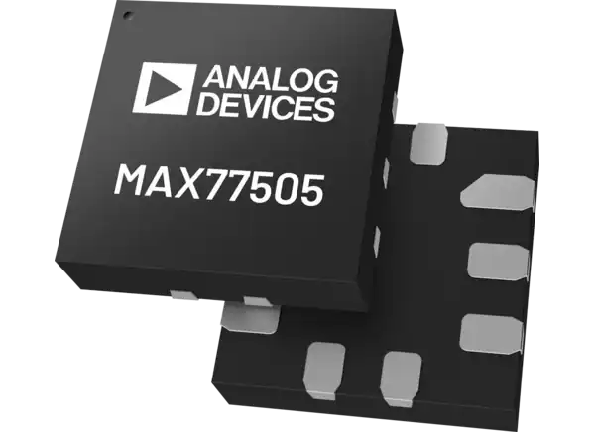
Voltage Regulation
Since both units require a 5V and 3.3V voltage rail, we will need efficient voltage regulation for both units
The control unit will be utilizing a 12V AC-DC power supply as an input while the battery will provide 9V to the vent PCB.
There are two main types of regulators we can use to accomplish this: switching regulators and Linear Regulators.
For heat concerns due to the low efficiency of linear regulators, as well as to maximize battery life, we opted to use switching regulators to step down to 5V on both board
Because of the nature of buck regulation, the step-down actually results in less current draw from the source depending on efficiency and difference between Vin and Vout. This would additionally increase battery life
We chose the MAX77505 buck regulator to supply our 5V rail on both units

Slide 25
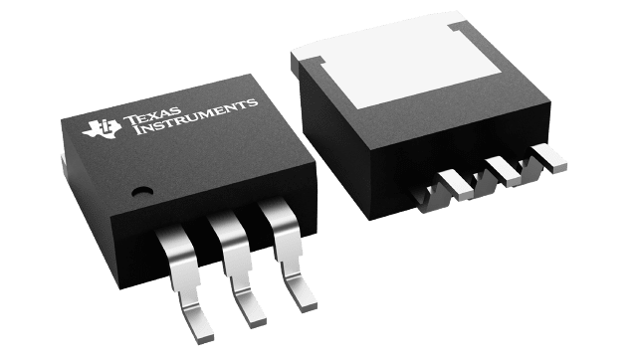
Control Unit Power Supply Design
Because linear voltage regulators are easier to solder, require less parts, and are less complex and sensitive in design, we opted to use a linear regulator for the 3.3V rail
We opted to use a low dropout regulator to give more headroom
Thermal calculations showed the SOT-23 package of the LM1117 LDO regulator was sufficient for stepping down 5V to 3.3V
Both units will have their power supplies on separate daughter boards to isolate potential issues.

Slide 26
Vent Power Supply Considerations
 | MAX77505 Buck Regulator(5V) + XC6206 LDO(3.3V) |  | Two MAX77505 Buck Regulators in Parallel (3.3V and 5V)
Efficiency (5V 800mA output) | 94% |  | 94%
Efficiency (3.3V 20mA output) | 66% |  | 91%
Source Current Draw ( at 3.3V with 20mA output) | 20mA |  | 8.05mA
Source Current Draw (@5V 800mA output) | 472.7mA |  | 472.7mA
Total Source Current Draw (neglecting quiescent current) | 492.7mA |  | 480.75mA
IC Cost | $3.22 |  | $5.44

Slide 27
05
Block
Diagrams

Slide 28
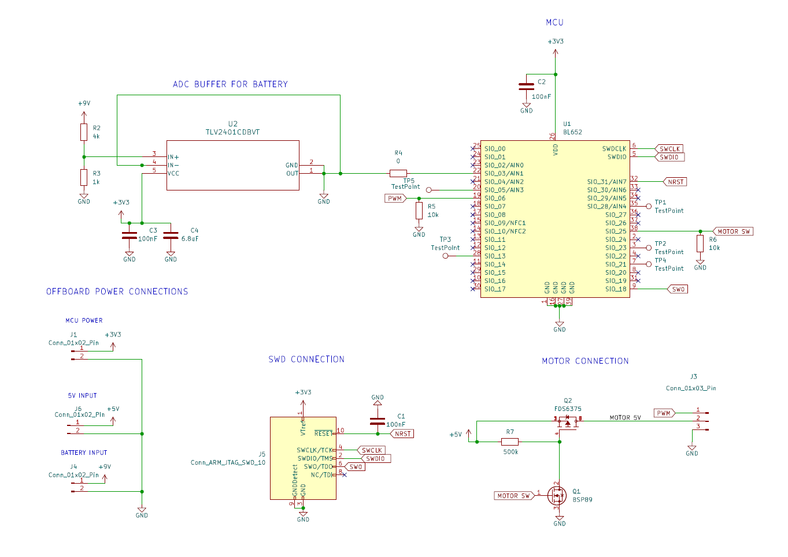
Overall Vent Unit Schematic

Slide 29
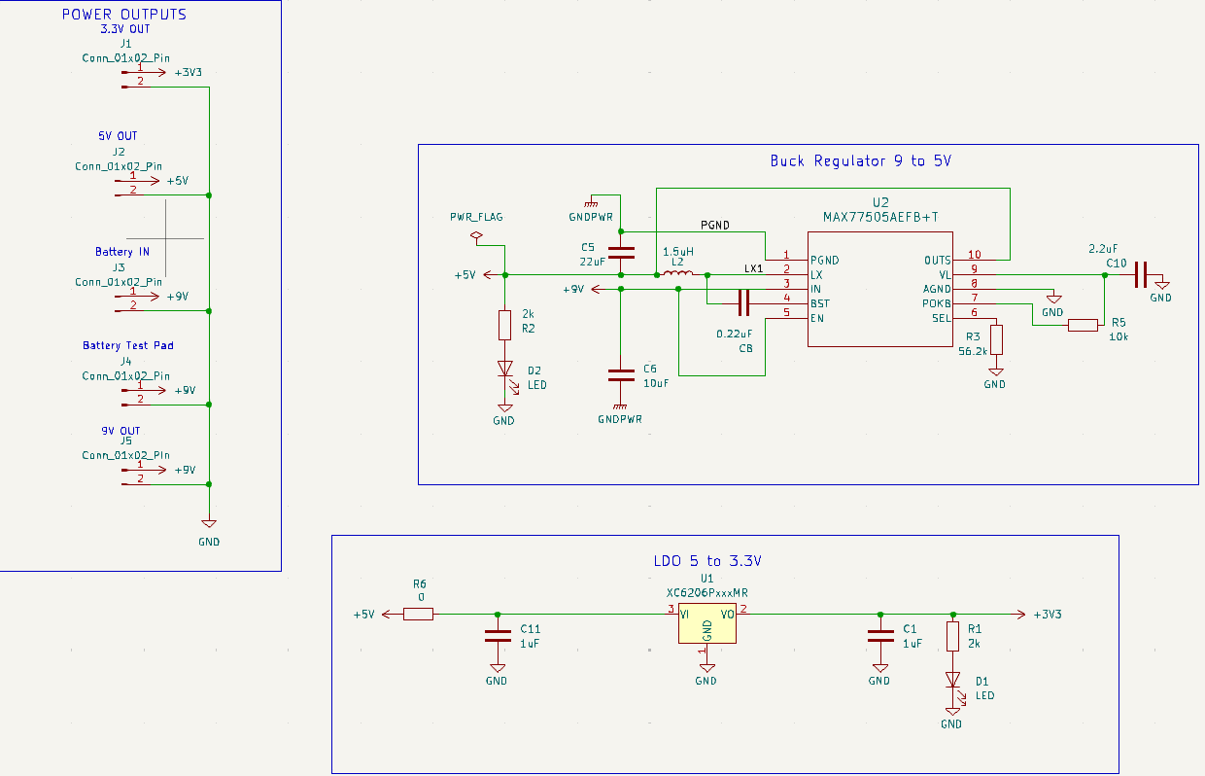
Vent Unit Power Supply Schematic

Slide 30
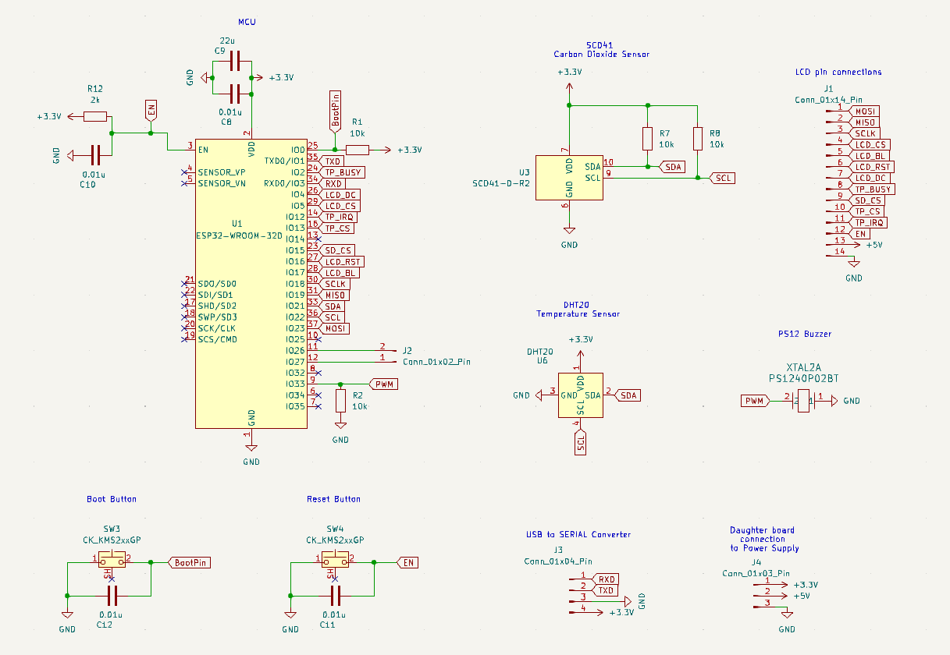
Overall Control Unit Schematic

Slide 31
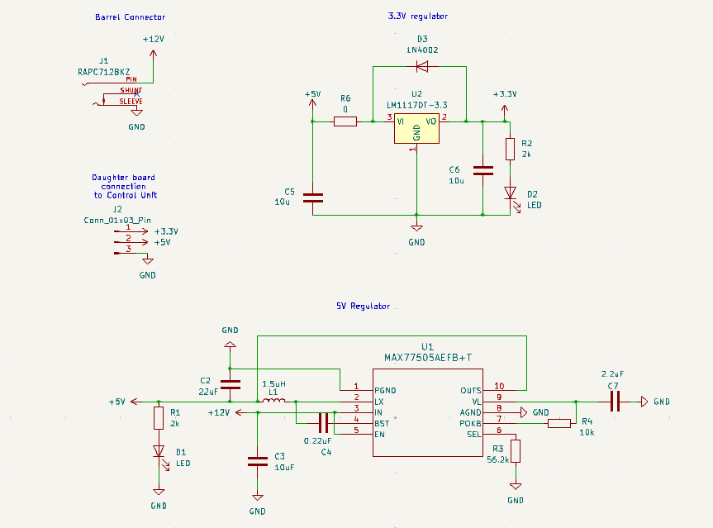
Control Unit Power Supply Schematic

Slide 32
06
PCB Design

Slide 33
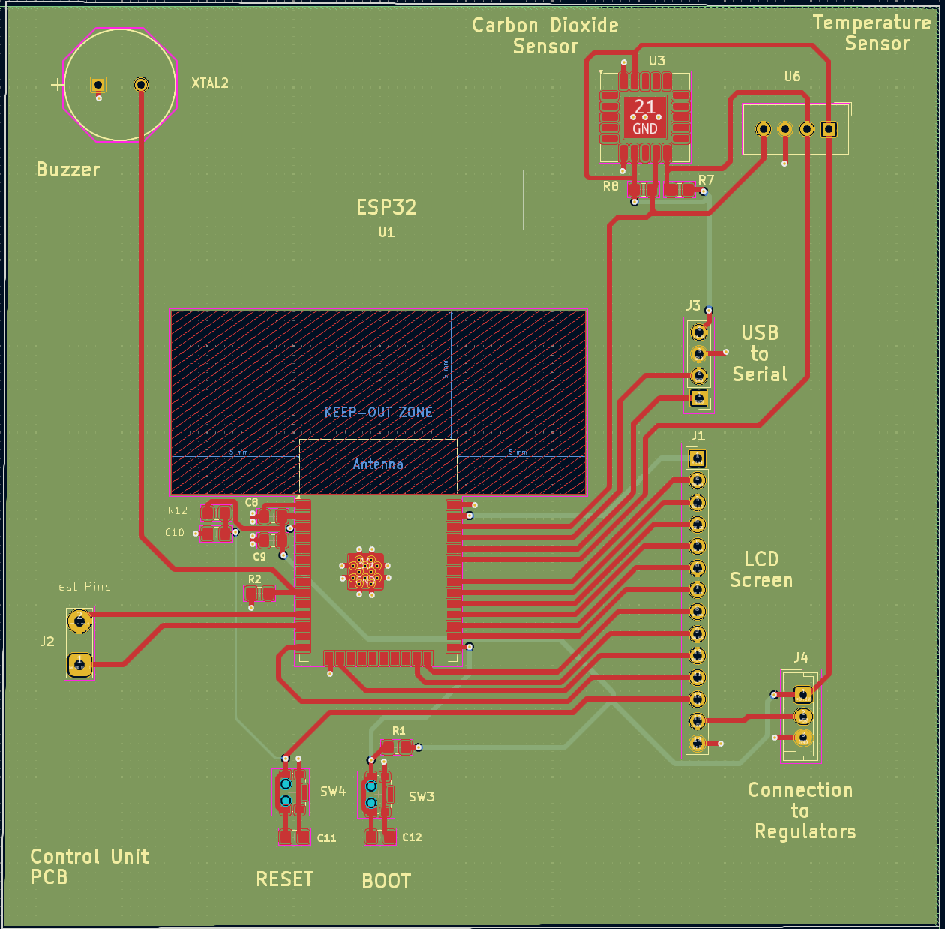
Control Unit PCB
Notes:
Utilizes a 4-layer board with 2 inner ground layers

Slide 34
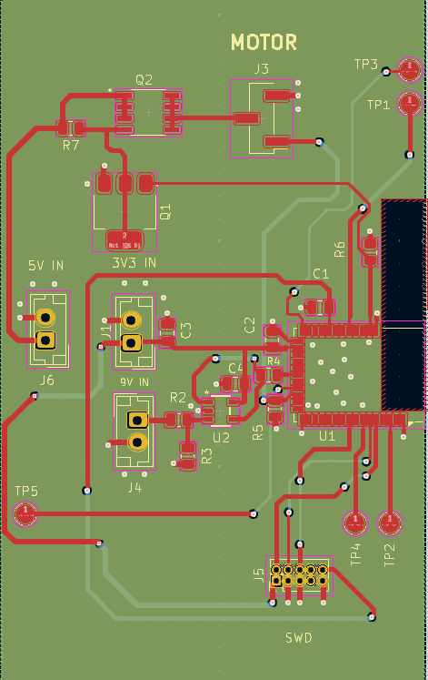
Vent Unit PCB
Utilizes a 4-layer board with 2 inner ground layers
NRF52832 antenna side is place close to the edge to maximize BLE range and efficiency

Slide 35
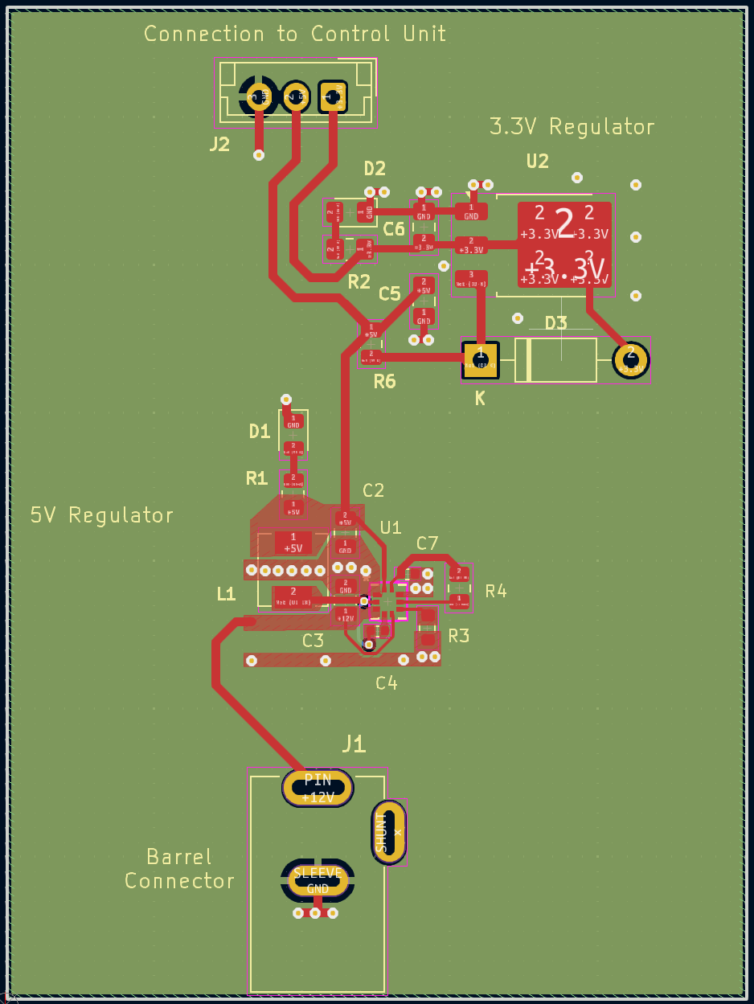
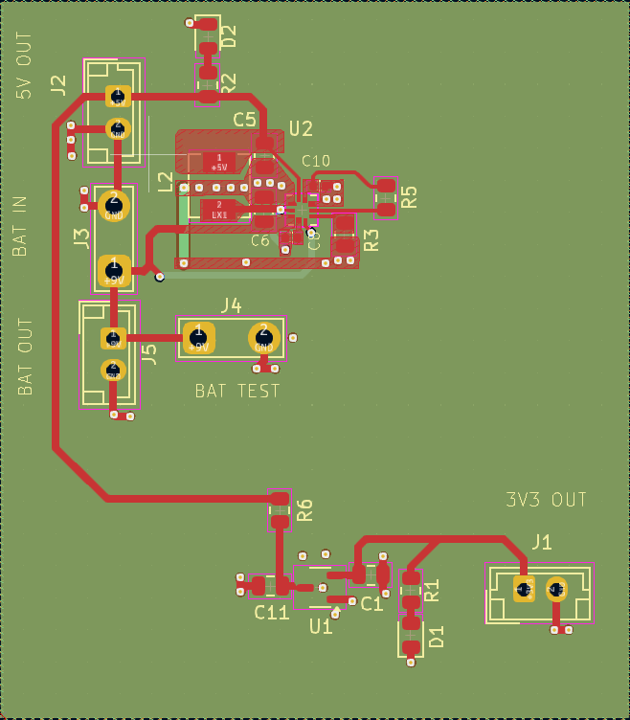
Control and Vent unit Power Supply PCB

Slide 36
07
Software Selection

Slide 37
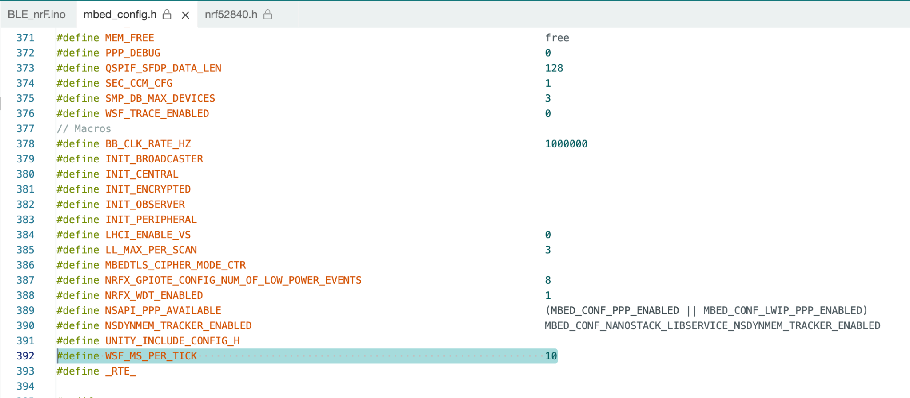
nRF52832 Operating System
 | Mbed OS (Arduino IDE) |  | Bare Metal (Nordic SDK)
Development Time | Faster |  | Slower
Current Draw LPM (@5V on development board) | 1.2mA |  | <100uA
Notes:
Planning on explaining during the video but both will be used

Slide 38
nRF52832
IDE / Dev Environments
 | Arduino IDE |  | SEGGER Embedded Studio |  | Visual Studio Code
Libraries / API / Extensions | A lot of native support (GPIO, BLE, etc), abstraction |  | Utilizes Nordic SDK, lower level |  | Lots of extensions for organization (clean code format, file exploration)
Community Support | Very High |  | High |  | High
Supported Languages | C, C++ |  | C, C++ |  | Any
Ability to upload code to Flash | Yes |  | Yes |  | No
Notes:
Same as before, all of the ides above will be used

Slide 39
ESP32 IDE Dev Environments
 | Arduino IDE |  | PlatformIO |  | Visual Studio Code
Libraries / API / Extensions | A lot of native support (GPIO, BLE, etc), abstraction |  | Provides support such as extensive library management and debugging capabilities |  | Lots of extensions for organization (neatness, file exploration)
Community Support | Very High |  | High |  | High
Supported Languages | C, C++ |  | C, C++ |  | Any
Ability to upload code to Flash | Yes |  | Yes |  | No
Notes:
Same as before, all of the ides above will be used

Slide 40
08
Software Design

Slide 41
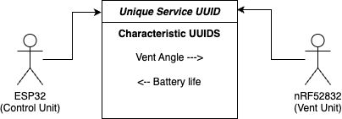
BLE Communication
Devices are able to subscribe to a service UUID to establish a connection
Each MCU can subscribe to a characteristic and publish information to it, which will automatically send a signal to the other MCU
Vent Unit will stay in low power mode until a signal is received, then adjust the vent
Control Unit will receive battery life signal and update the LCD screen

Slide 42
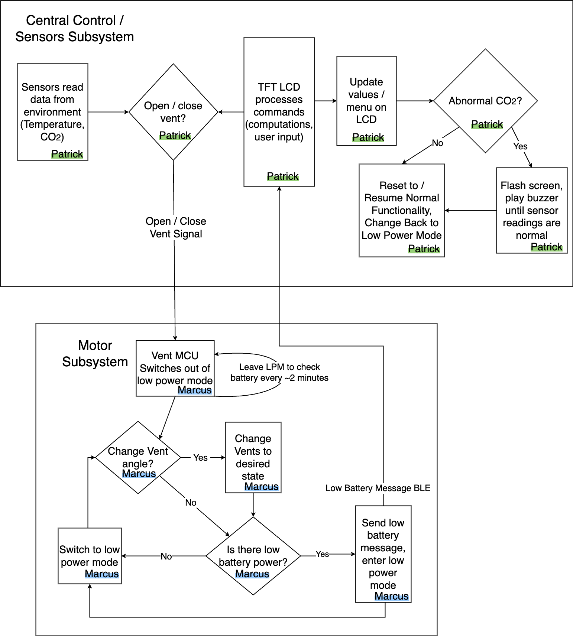
Software Block Diagram
Patrick

Slide 43
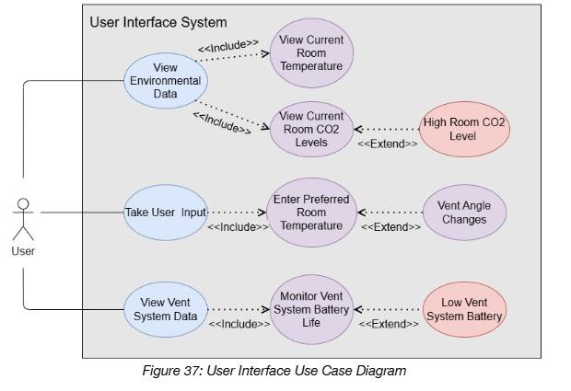
LCD Screen Use Case Diagram

Slide 44
09
Prototyping and Testing

Slide 45
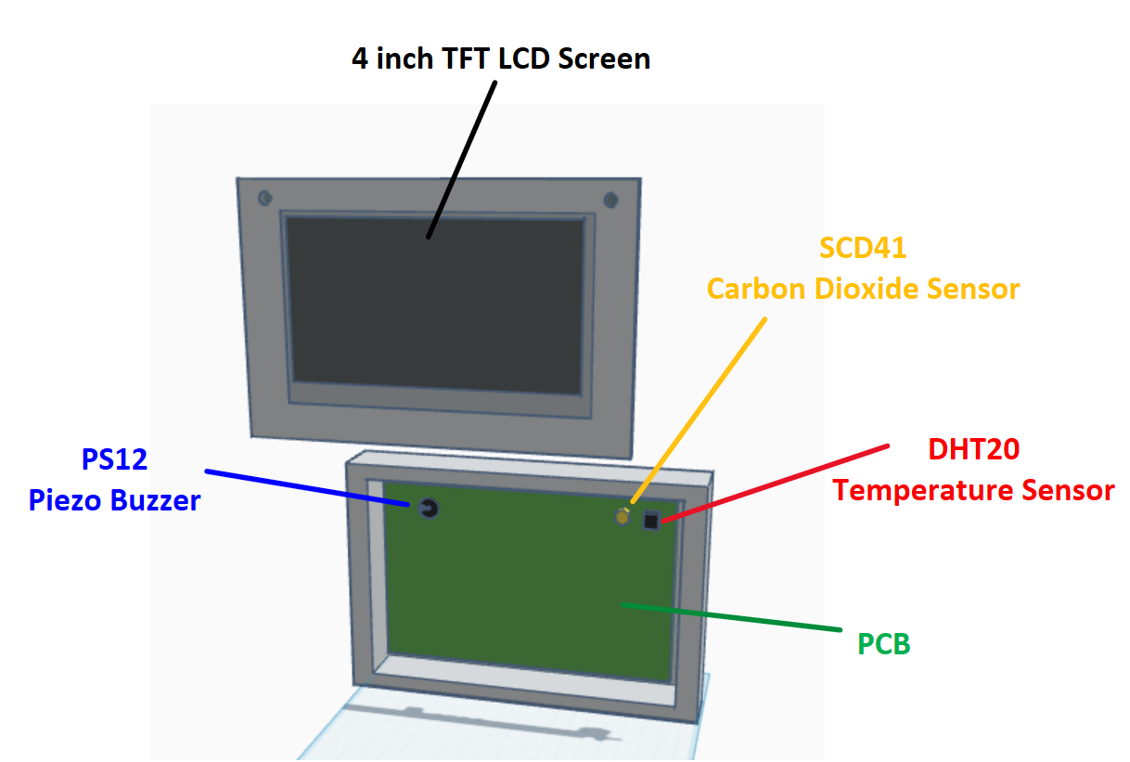
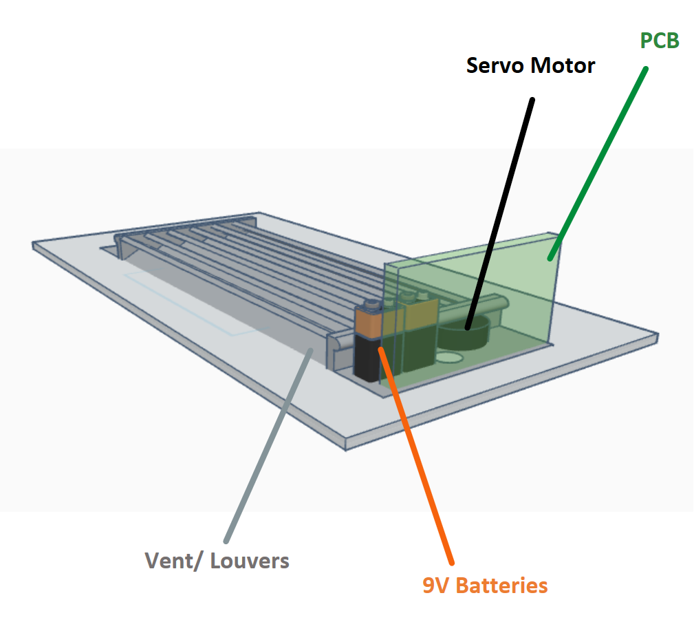
Construction Design Prototype
Control Unit
Vent Unit

Slide 46
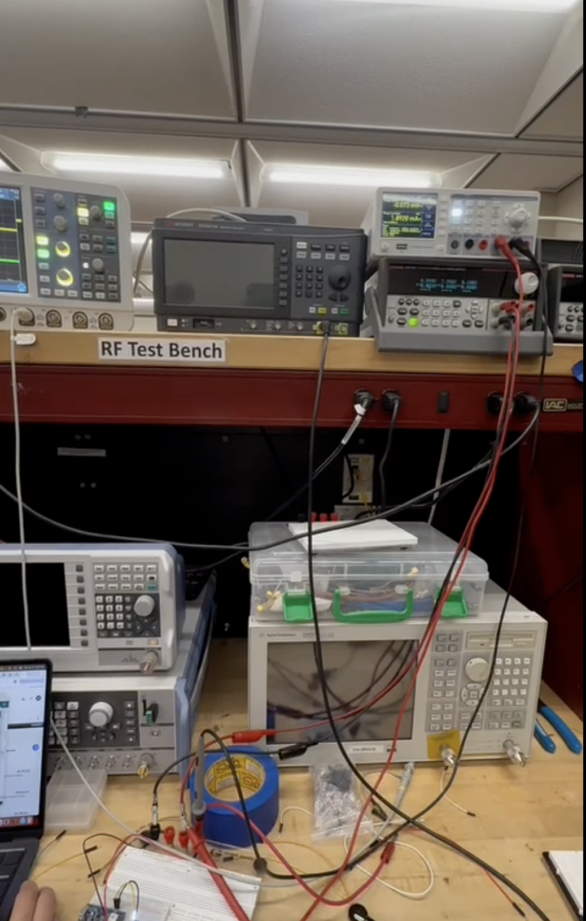
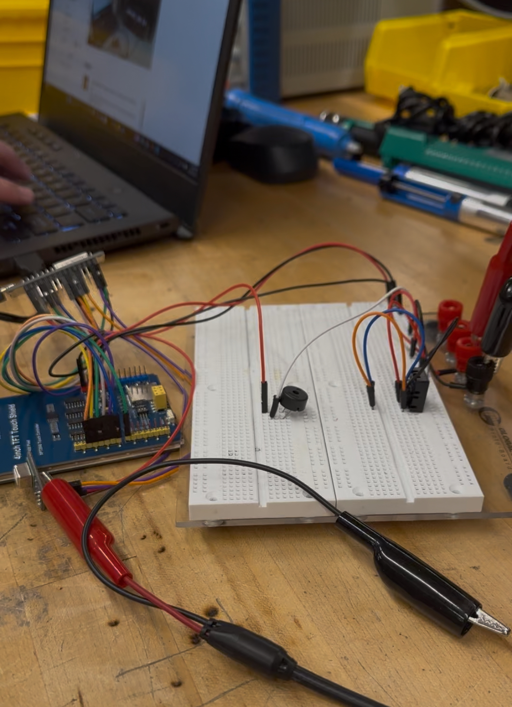
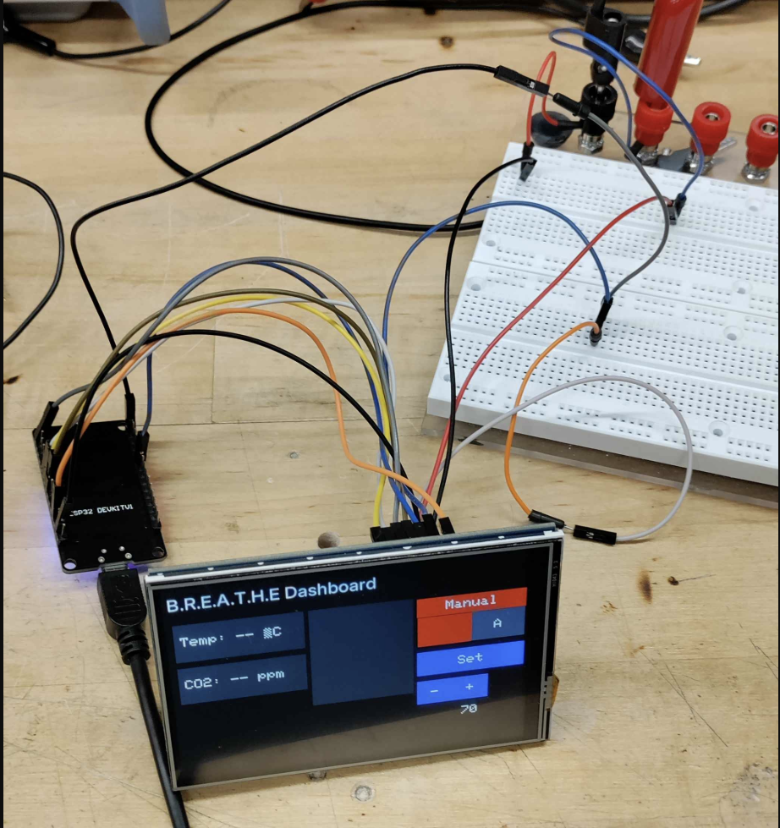
Prototype Testing

Slide 47
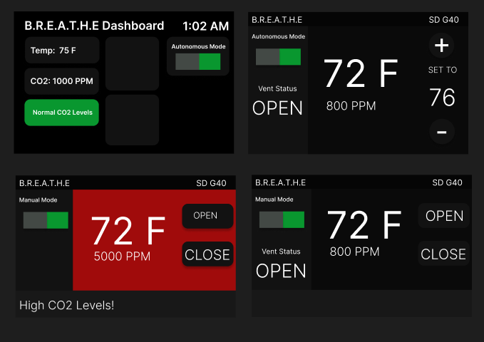
Various GUI Design Prototypes

Slide 48
10
Administrative Content

Slide 49
Budget
Item |  | Price |  | Quantity
NRF52832 DevKits |  | $24.95 |  | 2
NRF52832 module |  | $9.29 |  | 2
ESP32 WROOM 32 |  | $5.30 |  | 3
PCBs |  | $9.8915 |  | 20
PCB Additional Components |  | $48.90 |  | N/A
Voltage Regulators |  | $3.39 |  | 12
Carbon Dioxide Sensor |  | $31.02 |  | 2
Temperature Sensor |  | $4.50 |  | 2
Item |  | Price |  | Quantity
LCD Screen |  | $41 |  | 1
Battery |  | $18 |  | 1
Buzzer |  | $0.56 |  | 4
Sample Vent |  | $26.60 |  | 1
Servo Motor |  | $4 |  | 4
J-Link Debugger |  | $60 |  | 1
ESP32 Debugger |  | $6 |  | 2
Total |  | $618.87

Slide 50
Work Distribution
Emily Baross | Kyle Ingleton |  | Marcus Loyd |  | Patrick Tumbos
Control Unit PCB Design | Vent Interaction subsystem PCB Design |  | Vent Interaction Subsystem Software Design |  | Control unit Software/GUI Design
Vent Interaction Subsystem Enclosure Design | Power Supply Design |  | Motor Testing and Configuration |  | Temperature, Carbon Dioxide and Buzzer Software Design

Slide 51
Plan for completion
PCB Testing
(2/24 - 3/10)
Vent + Control Unit Subsystem integration testing
(3/10 - 3/24)
Control Unit GUI Completion
(3/24 - 4/1)
Nordic SDK Integration
(3/24 - 4/1)
Prepare for final Demo
(4/1 - 4/7)

Slide 52

Thanks for watching!

